Slide 1

Agentic RAG Chatbot
Multi-Format Document QA using Model Context Protocol (MCP)
Satwika Samsani

Slide 2
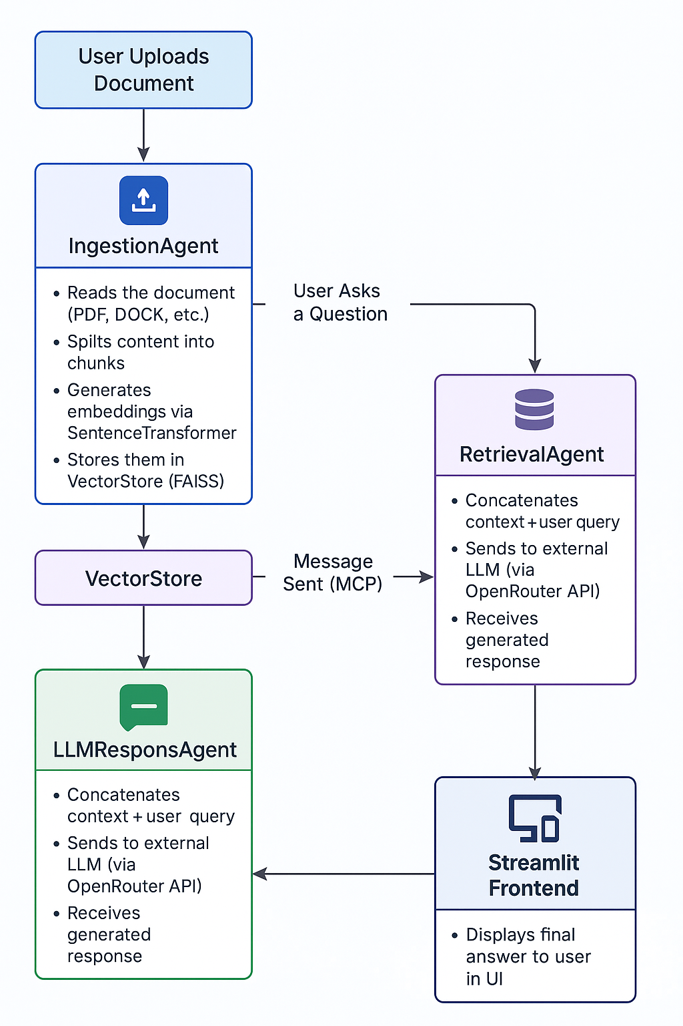
ARCHITECTURE
Here are two key points about the architecture shown in the diagram:
Agent-Oriented Modular Design: The system is built using dedicated agents IngestionAgent, RetrievalAgent, and LLMResponseAgent each responsible for a specific task in the RAG pipeline.
MCP (Model Context Protocol) Message Passing: Communication between agents is standardized via MCP, ensuring each message includes sender, receiver, type, trace ID, and payload. This facilitates traceability, debugging, and easy agent orchestration in a distributed system.

Slide 3
The Agentic RAG chatbot architecture is built around a multi-agent system where each agent is responsible for a distinct task in the Retrieval-Augmented Generation workflow.
IngestionAgent is the first in the pipeline, responsible for accepting user-uploaded documents in various formats (PDF, DOCX, PPTX, CSV, etc.), extracting the text content, and breaking it into manageable chunks. These chunks are then passed to the retrieval agent
RetrievalAgent, which uses semantic search powered by FAISS and SentenceTransformers embeddings to find the most relevant pieces of text in response to a user query. Once the top-matching chunks are identified, they are sent along with the query to the LLMResponseAgent
LLMResponseAgent, which constructs a prompt and communicates with an external Large Language Model (via OpenRouter) to generate a natural language response.
All communication between agents is facilitated using the Model Context Protocol (MCP), a lightweight message-passing format that ensures consistency and modularity across the system. This design enables the chatbot to intelligently retrieve and reason over document content to provide accurate, context-aware responses.

Slide 4
TECH STACK:
Python 3.10+ – Core programming language
FAISS – High-performance similarity search for vector storage
SentenceTransformers – Embedding generation using all-MiniLM-L6-v2
OpenRouter API – Interface to powerful models like GPT-3.5, Claude, Mixtral
Model Context Protocol (MCP) – Lightweight message protocol for agent communication
Multi-Agent Architecture
IngestionAgent – Handles document chunking and preprocessing
RetrievalAgent – Performs similarity search over stored vectors
LLMResponseAgent – Crafts final prompt using retrieved context and calls LLM
Streamlit – Lightweight UI framework for chatbot interface and file uploads
Authentication / API Keys - Hugging Face API – (Optional) for hosted models and embeddings
dotenv – Manage environment variables securely

Slide 5
System Flow (Message Passing Sequence)
Message Sent (MCP):
"sender": "IngestionAgent",
"receiver": "RetrievalAgent",
"msg_type": "STORE_CHUNKS",
"trace_id": "abc123",
"payload": {
"chunks": [ ... ]
}
User Uploads Document
IngestionAgent
RetrievalAgent
User Asks a Question
Message Sent (MCP):
"sender": "RetrievalAgent",
"receiver": "LLMResponseAgent", "msg_type":"CONTEXT_RESPONSE",
"trace_id": "abc123",
"payload": {
"query": “user query”
"top_chunks": [ ... ]
}
RetrievalAgent
LLMResponseAgent
Streamlit Frontend

Slide 6
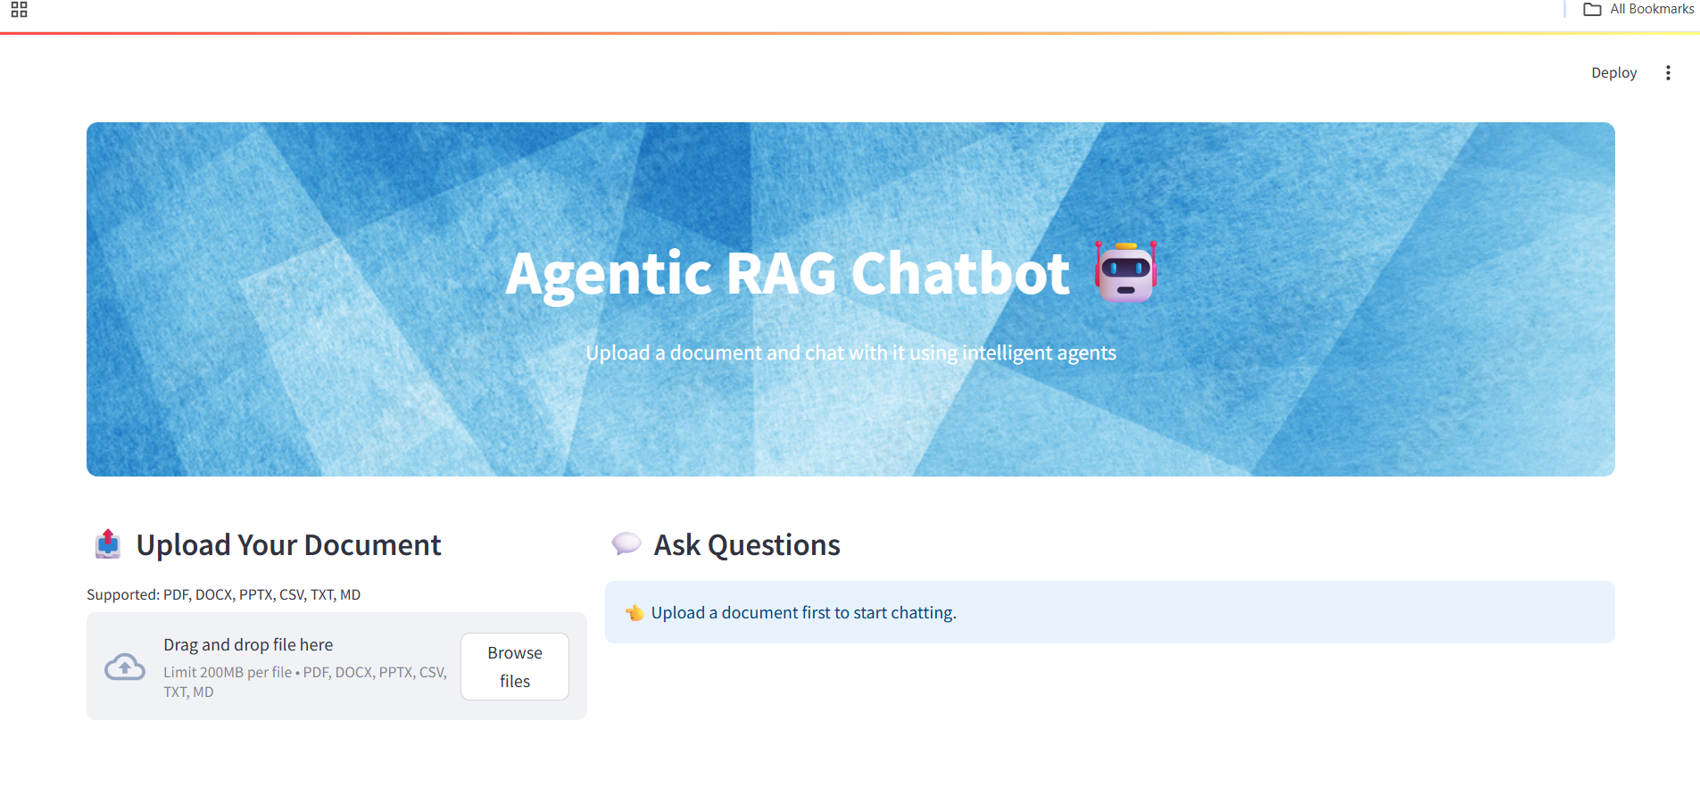
UI screenshots of working app

Slide 7
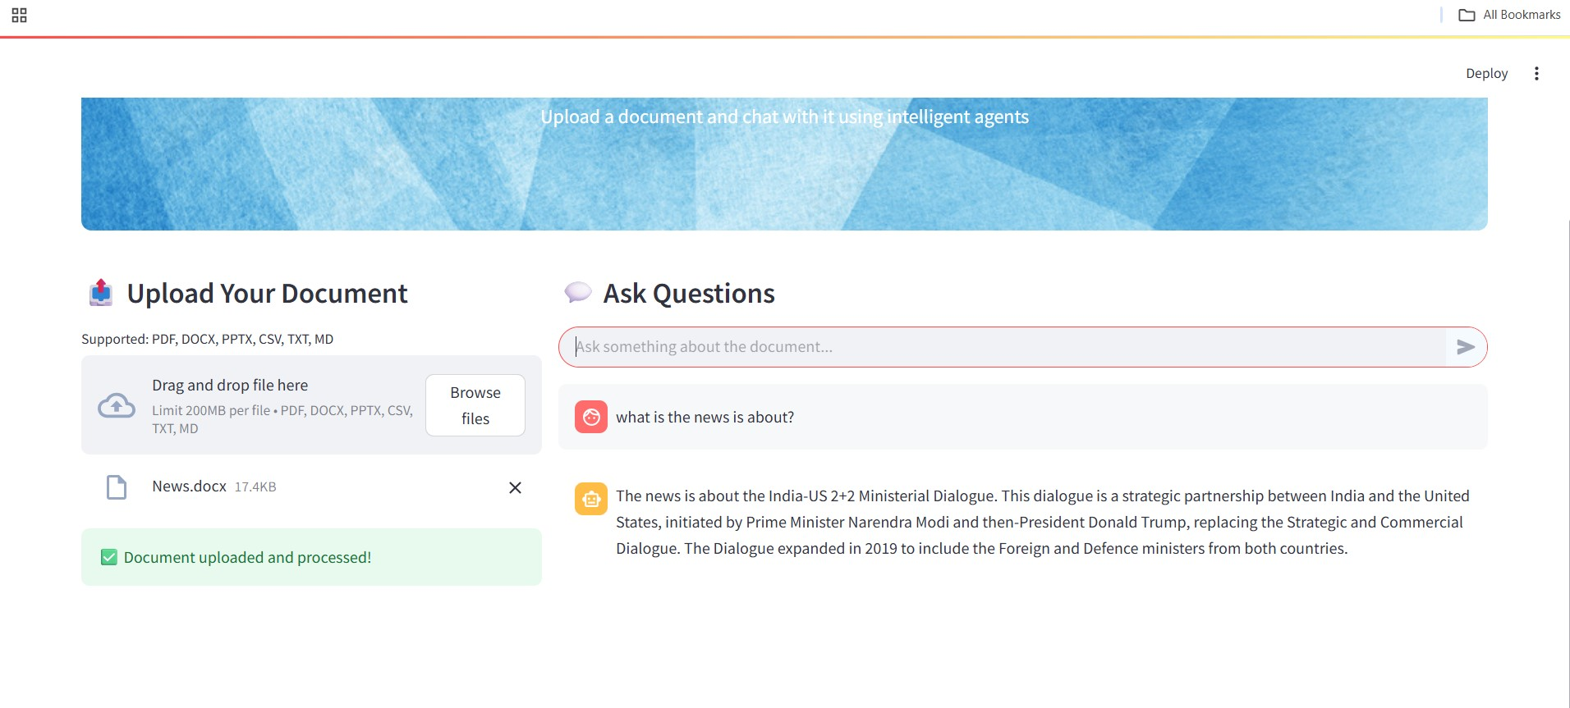

Slide 8
Challenges Faced During the Project
Embedding Quality vs. Latency
Balancing between fast embedding generation (using all-MiniLM-L6-v2) and achieving contextually rich results was tricky—especially when document sizes increased.
LLM Token Limits & Prompt Design
Crafting prompts that fit within the token limits of different LLMs while still including context, instructions, and user queries required iterative experimentation.
Limited Compute Resources
Without access to high-end GPUs or paid LLM APIs, optimizing performance while staying on free-tier limits was a continuous constraint.

